Slide 1

Pest Recognition in Greenhouses Using Vision Technology
Pest Classification Using Convolutional Neural Networks (CNN) Objective: Classify pest species from images to support agricultural pest monitoring.
PRIYA SIROHI | PRIYANKA KUMARI

Slide 2
DATASET
Dataset structured into train and test folders.
Each pest type has its own subfolder as label.
Total Classes: 9 pest categories.
Images are real-world pest samples from greenhouse environments.
Data Preprocessing
Images resized to 128x128 pixels.
Pixel values normalized to 0-1 range.
Labels assigned based on subfolder names.
Preprocessing ensures uniform input for model training.

Slide 3
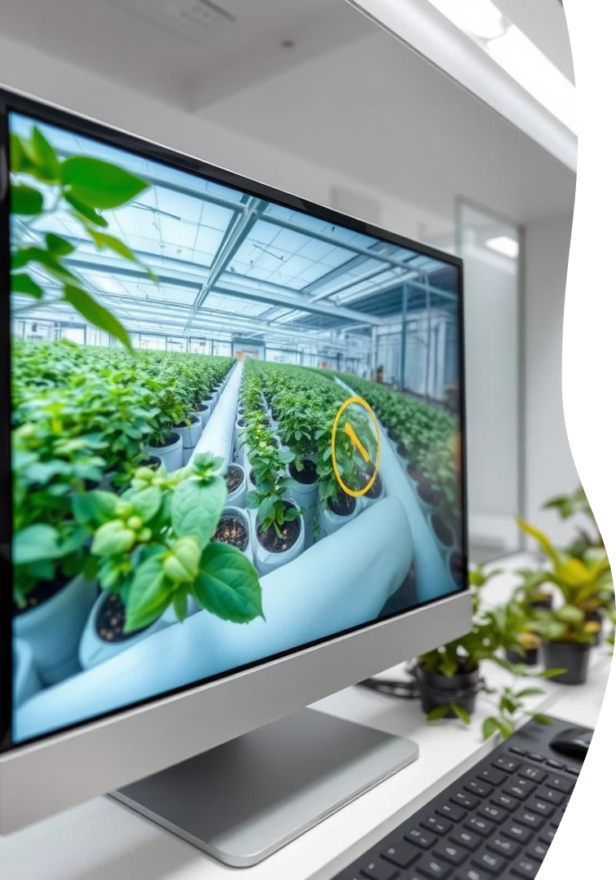



Introduction to Vision Technology
Automated Pest Identification
Integrated System
Integrates cameras, AI models, and analytics in real-time. Data processing is quick.
Computer vision enables automated pest identification. This technology enhances monitoring.
Reduced Labor
Reduces labor needs while increasing detection speed. Automation is key.

Slide 4
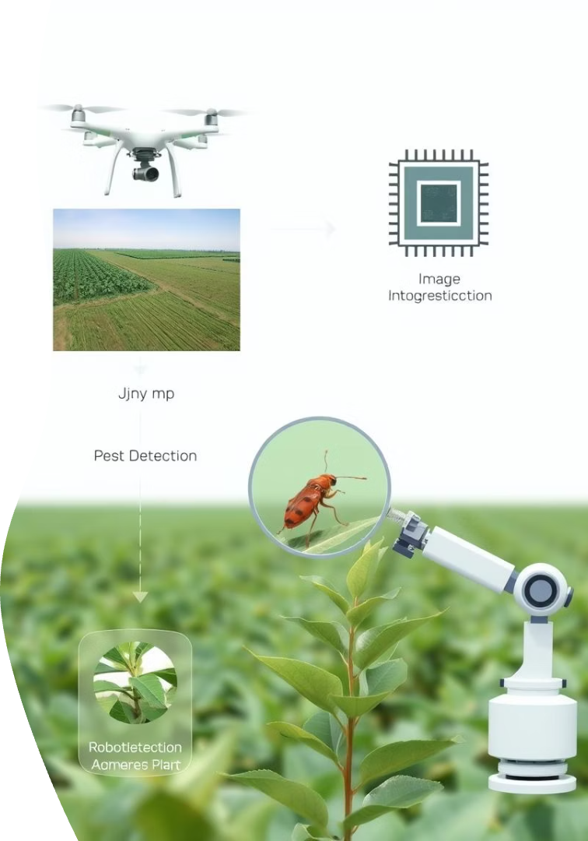



MODEL ARCHITECTURE
Base: Convolutional Neural Network (CNN).
Layers used:
Convolution layers for feature extraction.
MaxPooling layers for downsampling.
Fully connected Dense layers for decision making.
Softmax layer for multi-class classification.
Output: Probability distribution across all pest classes.

Slide 5

Training Process
Learning through forward pass & backpropagation.
Input: Preprocessed images and their corresponding labels.
Training performed for limited epochs due to computational constraints
Output: A trained .h5 model file

Slide 6




Accuracy Evaluation
Accuracy depends on:
Dataset size.
Epoch count.
Model complexity.
Current training shows:
Training Accuracy: Moderate.
Test Accuracy: Affected by undertraining and limited data.
Occasional misclassification observed due to visual similarity between pests and insufficient samples.

Slide 7



: Prediction Process
Class with highest probability selected as prediction.
2
New image undergoes the same preprocessing steps.
Model outputs probability for each pest class
1
Output can be visualized as percentage confidence per class.
3

Slide 8



CONCLUSION
CNN-based classification enables fast and scalable pest detection
Early-stage model demonstrates potential despite limitations.
Future improvements:
More data, deeper networks, longer training.
Real-time and embedded solutions for smart agriculture.

